Slide 1
TWO-THIRD WORLD
ROLES & RESPONSIBILITY
IN WORLD EVANGELISATION
Pathway to the Nations:
Church of Nigeria, Anglican Communion
World Missions Congress
1-4 October 2025
Fred Dimado – Pioneers International

Slide 2
The Shift !
-For the first time in the modern mission era , the center of gravity of Christianity has moved without any argument , doubt or debate, from the West to the rest of the world. It’s Africa , Asia, Latin America , the Pacific Island and the MENA (Middle East & North Africa Regions)
Not a change of baton but God adding more hands for the harvest that He is cultivating

Slide 3
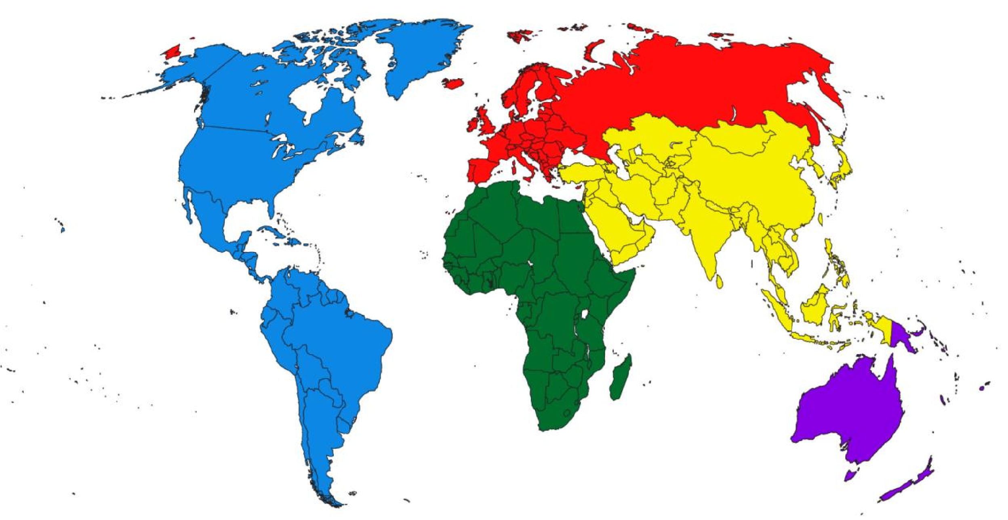






UNEVANGELIZED INDIVIDUALS, IN MILLIONS
11.9
SOURCE: Joshua Project; (image) Operation World
SOURCE: World Christian Database

Slide 4






UNREACHED PEOPLES BY CONTINENT
223
SOURCE: Joshua Project; (image) Operation World
SOURCE: Joshua Project

Slide 5

Asia
70% of the world’s Muslims
77% of the world’s non-religious
98% of the world’s Hindus
99% of the world’s Buddhists
15% of the World’s Christians
85% of the World’s unenvangelised, 500 million in India alone

Slide 6
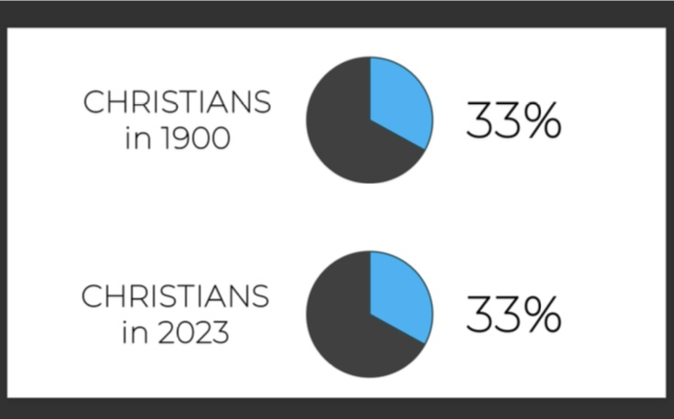

Slide 7
Outline
A significant shift in modern mission era
Discerning the world of our day -3 issues
Roles and Responsibilities through God’s eyes
Implications of Africa’s christian population growth
Roles and Responsibilties
Example from Singapore & Testimony of an African in Asia

Slide 8
Majority World Leadership (Role & Responsibilities )
Prioritizing spiritual formation and connectedness to the vine
Missiological alignment with what God is doing
Church denominations, mission agencies ,Christian organizations' awareness of what God is doing
Leadership understanding that sets direction and focus

Slide 9
Majority World Leadership (Role & Responsibilities )
“ Majority world leaders seek as a movement under God , to shape and influence the vision , scope , scale and health of Majority World missions “ for local and global gospel advance and impact.
-Coordinate efforts through facilitating teams , catalyze and support intra-denominational, agency collaboration and partnerships (nationally, regionally and globally)

Slide 10
Majority World Leadership (Role & Responsibilities )
A majority world missional movement that will :
“embody the inspiration & authority of the Holy Scriptures, reflect a dependency on the help and guidance of the Holy Spirit , build an enabling and inclusive environment that seeks the thriving and flourishing of all “- Harvey Kwiyani

Slide 11
Why “Two-Third World” ?
A prophetic, inclusive and inter-generational call of faith
Fred Dimado - Pioneers

Slide 12
“Now faith is the assurance of things hoped for , the conviction of things not seen . For by it the people of old received their commendation”
Heb 11:1-2
Notes:
Jesus lived with an awareness of the Father’s sovereign timing in His life and ministry and with the knowledge that God was doing something through him as part of a vast eternal plan. This Jesus learned to watch and see what the father was doing anf then enter into God’s everlasting work.

Slide 13
“Arise, shine , for your light has come and the glory of the Lord has risen upon you . For behold , darkness shall cover the earth and think darkness the peoples but the Lord will arise upon you and his glory will be seen upon you and the nations shall come to your light and the Kings to the brightness of your rising “ Is 60:1-3
Notes:
Jesus lived with an awareness of the Father’s sovereign timing in His life and ministry and with the knowledge that God was doing something through him as part of a vast eternal plan. This Jesus learned to watch and see what the father was doing anf then enter into God’s everlasting work.

Slide 14
“Thus says the Lord, who makes a way in the sea
A path in the mighty waters
Who brings forth chariot and horse, army and warrior ; they lie down , then cannot rise
They are extinguished , quenched like a wick
Remember not the former things
Nor consider the things of old
Behold , I am doing a new thing
Now it springs forth , do you not perceive it
I will make a way in the wilderness & rivers in the desert “ Is 43:16-19
Notes:
Jesus lived with an awareness of the Father’s sovereign timing in His life and ministry and with the knowledge that God was doing something through him as part of a vast eternal plan. This Jesus learned to watch and see what the father was doing anf then enter into God’s everlasting work.

Slide 15

TWO THIRDS OF ALL CHRISTIAN POPULATION GROWTH FROM 2000-2050 WILL BE IN AFRICA
CHRISTIAN POPULATION INCREASE 2000-2050
GLOBAL TOTAL: 1.35 billion
CHRISTIAN POPULATION INCREASE 2000-2050
AFRICA TOTAL: 901 million
AFRICA
Fred Dimado - Pioneers

Slide 16
ALL CHRISTIANS
2050
2000
19.1%
38.4%
Africa
Rest of World
Source: World Christian Database
Notes:
Many of us may not be alive in 25 years time but we have a responsibility to serve towards quality growth in gospel expansion

Slide 17
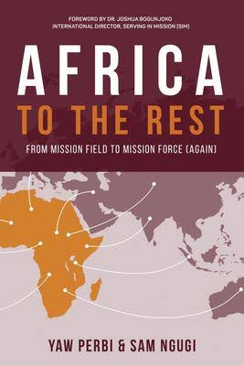
Present Potential
1. Dynamic Harvest Force
2. Spiritual Resourcefulness
3. African Personality
4. Rising Economies

Slide 18
Persistent Problems
1. Wrong Mindsets
2. Inward-Looking
3. Shallow Discipleship
4. Church Brands & Personality Cults
5. Undeveloped Mission Infrastructure
6. Other Challenges

Slide 19
Roles & Responsibility
“Christian advance in the world is serial and, in the providence of God, it is the Christians of Africa and Asia and Latin America and the Pacific that are next in the series. We who belong to the West are no longer the leaders, the initiators, the norm setters. We are now to learn to be the helpers, the assistants, and the facilitators….
It means that the Christians of the southern continent are now the representative Christians, the people by whom the quality of the 21st and 22nd Century Christianity will be judged, the people who will set the norms, the standard Christians. And the quality of 21st Century Christianity will depend on them.”
- Andrews Walls

Slide 20
Roles & Responsibility
It means that the Christians of the southern continent are now the representative Christians, the people by whom the quality of the 21st and 22nd Century Christianity will be judged, the people who will set the norms, the standard Christians. And the quality of 21st Century Christianity will depend on them.” - Andrews Walls
What Christian norms?
What standard of Christianity?
What quality of 21st Century Christianity?

Slide 21
“One mile wide and an inch deep” ?
“One inch wide and not even an inch deep”?
We need to “accept mutual prophetic critique” that offers feedback for repentance, renewal and hope.

Slide 22
How does God view the Church in the Majority World or The West ? Need for new humility
“You say, I am rich; I have acquired wealth and do not need a thing.’ But you do not realize that you wretched , pitiful , poor , blind and naked ( Rev 3:17 )
Notes:
Jesus lived with an awareness of the Father’s sovereign timing in His life and ministry and with the knowledge that God was doing something through him as part of a vast eternal plan. This Jesus learned to watch and see what the father was doing anf then enter into God’s everlasting work.

Slide 23
Roles & Responsibilities
Servant & Collaborative Leadership
Intercessors Initiators
Norm Setters
Helpers
Assistants
Facilitators /Catalyst
Missionaries
Missiologist/Theologians
Resource-linkers & Resource Discovery/development & Release
“Midwives”
Champions
Diplomatic Advocacy
Advocates &Others…

Slide 24
Role & Responsibilities
-Energise global conversations
-Stimulate creative thinking across cultures
-Facilitative & Catalyzing roles for the growth of global Christianity
-Stimulate vibrancy in the body of Christ
-Bring innovation, boldness in evangelism
-Vibrancy that enables the gospel to flow across cultures
-Preserve the integrity of the Christian faith

Slide 25
Roles & Responsibilities
“ Majority world leaders seek as a movement under God , to shape and influence the vision , scope , scale and health of Majority World missions “ for local and global gospel advance and impact.
Gospel bearers who know how to invite, welcome and enable multicultural worship spaces locally & globally

Slide 26
Roles & Responsibilities
“ Majority world leaders seek as a movement under God , to shape and influence the vision , scope , scale and health of Majority World missions “ for local and global gospel advance and impact.
Gospel bearers who know how to invite, welcome and enable multicultural worship spaces locally & globally

Slide 27
Roles & Responsibilities
A Church that prepares everyone to “give the reasonfor the hope that is within us “ I Peter 3:15

Slide 28
Pathways
Marketplace Christians
International Students
Lay people carrying the gospel as they go
Missionaries (in culture , near culture and far culture)

Slide 29
Final Thoughts , An example of a Collaborative effort and a testimony from an African family in Asia

Slide 30
So Jesus said to them,
“Truly truly I say to you, the Son can do nothing of His own accord, but only what He sees the Father doing.
For whatever the Father does,
that the Son does likewise.”
John 5:19
Notes:
Jesus lived with an awareness of the Father’s sovereign timing in His life and ministry and with the knowledge that God was doing something through him as part of a vast eternal plan. This Jesus learned to watch and see what the father was doing anf then enter into God’s everlasting work.

Slide 31
John 5:19
Towards Roles and Responsibility
ALERTNESS
DISCERNMENT
ENGAGEMENT
Notes:
Jesus lived with an awareness of the Father’s sovereign timing in His life and ministry and with the knowledge that God was doing something through him as part of a vast eternal plan. This Jesus learned to watch and see what the father was doing and then enter into God’s everlasting work.

Slide 32
Alertness. Discernment . Engagement
1. A world in a troubled place
2. A world in need of Jesus
3. A continent rising with the Gospel –Africa!
Building a momentum of local and global
gospel advance and impact

Slide 33
An example of a Gospel Response from churches, denominations and mission agencies in
Singapore for Asia

Slide 34
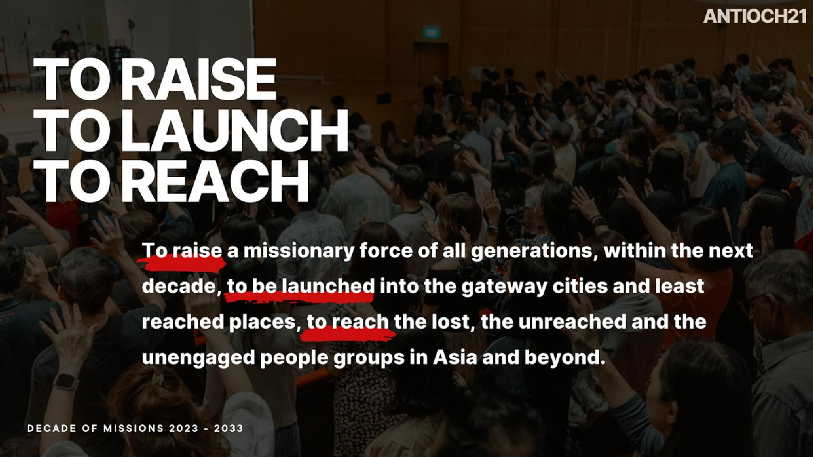

Slide 35
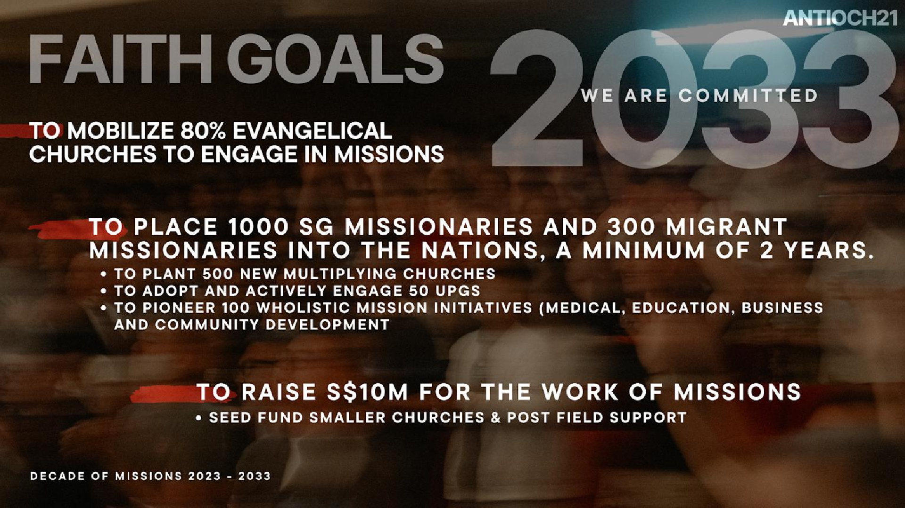

Slide 36

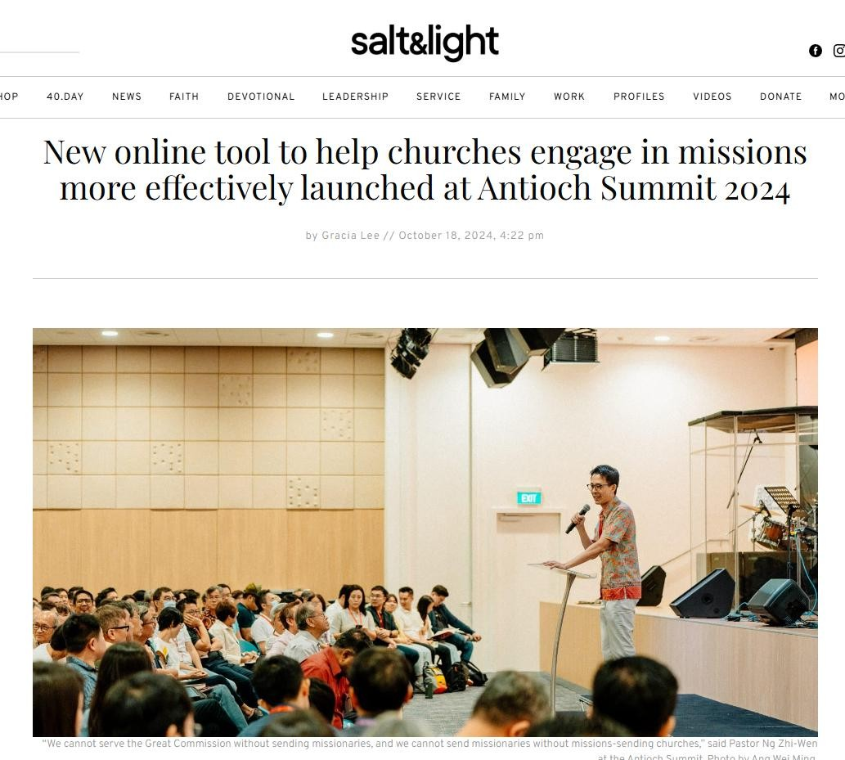


Take it anytime here: https://tinyurl.com/a21cmra

Slide 37
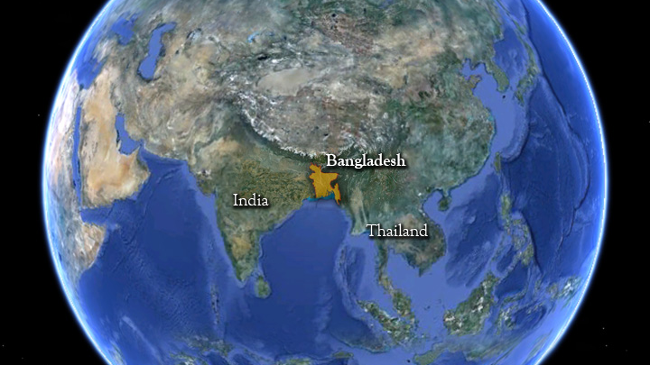
Population: 173.6 million
Religion: 91% Muslim
Major People Group:
Bengali Muslim,
158m in Bangladesh
0.006% Christian
Notes:
We are in Bangladesh…
Why are we all the way over there? Well it starts with the gospel. Unless you understand the gospel, it doesn’t really make any sense for us to be over there! A lot of people in Bemidji think its crazy that we are over there and a lot of people in Bangladesh think it’s crazy that we are there.

Slide 38
“African Church is becoming increasingly missional, her migrant populations are seeing increassing numbers of African initiated churches in North Africa, North America, Europe and Asia. It’s not because of her wisdom and strategies but because of the winds of change breathed upon the continent by the Holy Spirit “
Dr. Femi B. Adeleye

Slide 39
End.
God bless you !

